Slide 1

*ADD PICTURE*
FIFA 2019
PRESENTED BY:
LYLE SWEET
NATALIE MAIZE SLAV PETKOVIC
TIM VEAL
TROY HOLLOWAY
ANALYTICS

Slide 2


Hypothesis
The increasing interest for soccer from sports enthusiasts is at an all time high in Atlanta, Ga. Atlanta residents can now show support for the newly established a MLS team. Atlanta United was established in 2014 and joined the MLS in 2017, as the twenty-second team in the league. Atlanta United won the MLS 2018 Championship. Venues in Atlanta are supporting and hosting FIFA World Cup events. The large FIFA following sparked the interest to take a deeper drive in analyzing player statistics to gain a better understanding of team dynamics and the game of soccer.
We chose to identify player statistics to determine correlations between each of the following: which country produces the best players - countries wealth vs talent and which heights correspond to defensive players’ scores.
Hypothesis –
(1) There is a correlation between GDP and percent of talent country is able to produce.
(2) There is an ideal height or range for defensive players to perform optimally.
(3) Is there a correlation between Potential and Wage and Age/Potential and Wages?
Null Hypothesis –
(1) GDP does not affect the percentage of talent.
(2) There is no correlation between defensive player score and height.
(3) Players with higher potential will receive higher wages than those identified with lower potential.

Slide 3
Data Source Exploration/Cleansing
Data Sources:
FIFA Data Set: https://www.kaggle.com/karangadiya/fifa19
GDP Data Set: http://worldpopulationreview.com/countries/countries-by-gdp/
Currency Exchange API : https://v3.exchangerate-api.com/bulk/62a214ded52f89b9f8343997/USD
GitHub Project Location:
https://github.com/nmaize/Project-One_Group5/blob/master/FIFA_RESEARCH.ipynb
Data Exploration/Cleansing
Data Loaded into Jupyter Notebook
Explored both sets with .head() and .columns to get familiar with the data
Selected subset of data from each data set, removed duplicates and renamed the columns
Grouped all Great Britain countries as UK within FIFA data set since GDP set has it grouped all together
Merged FIFA and GDP data frames using Nationality as common column
Used API to get current rates between EURO and US Dollar for converting all monetary columns into US Dollar
Extracted Euro, M and K characters from current monetary columns and converted into float type
Converted height into inches and extracted all pounds (lbs) out from weight column
Finally, produced clean dataset and plotted data set heat map

Slide 4
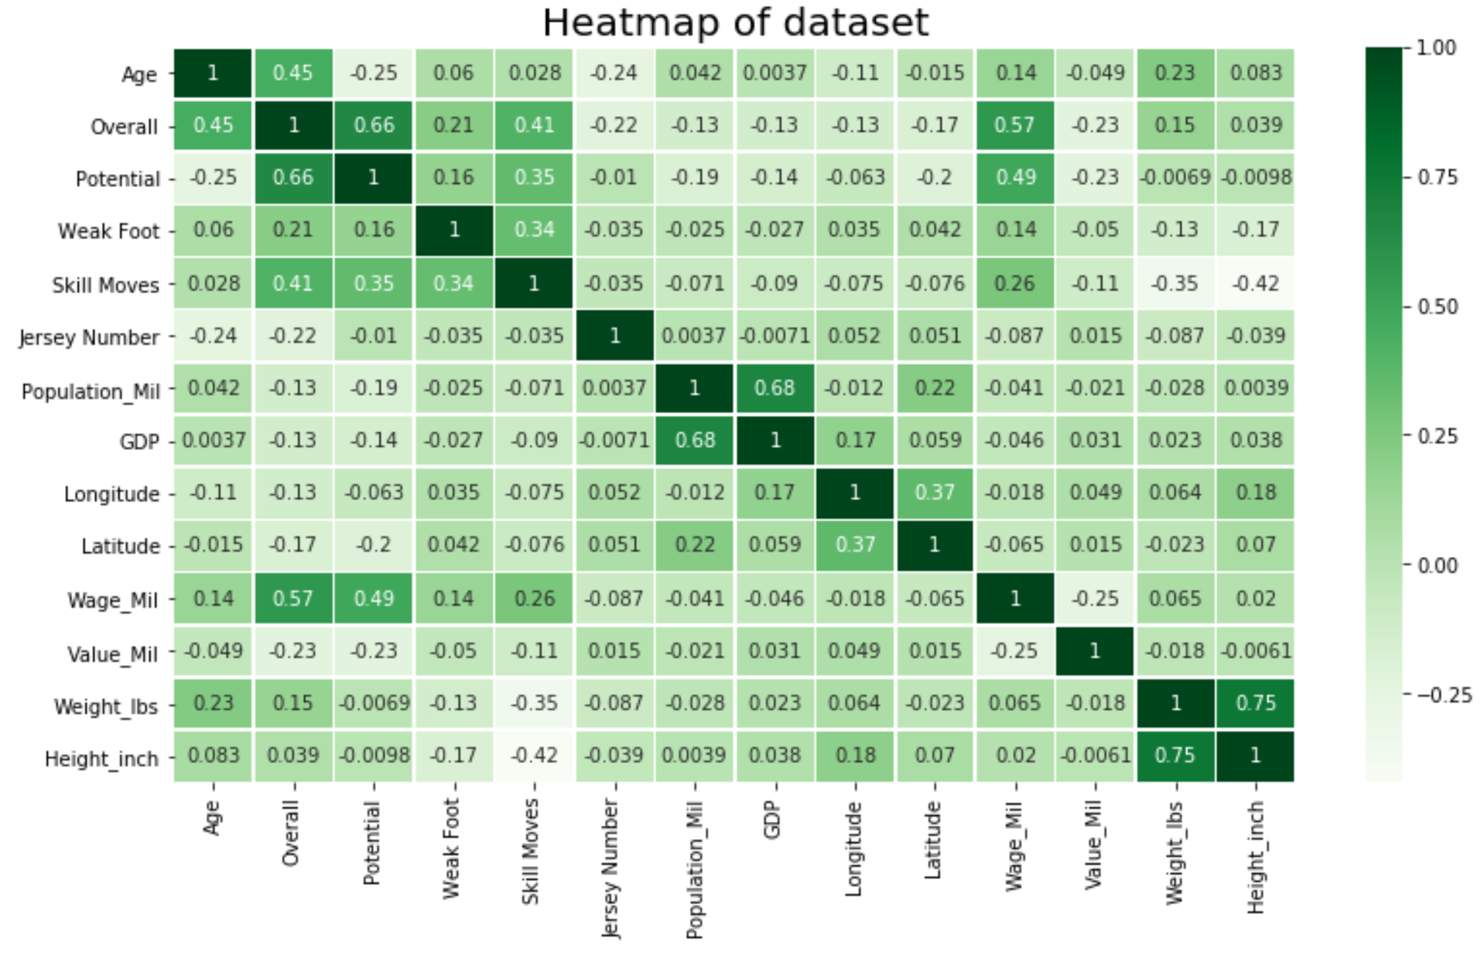

Slide 5
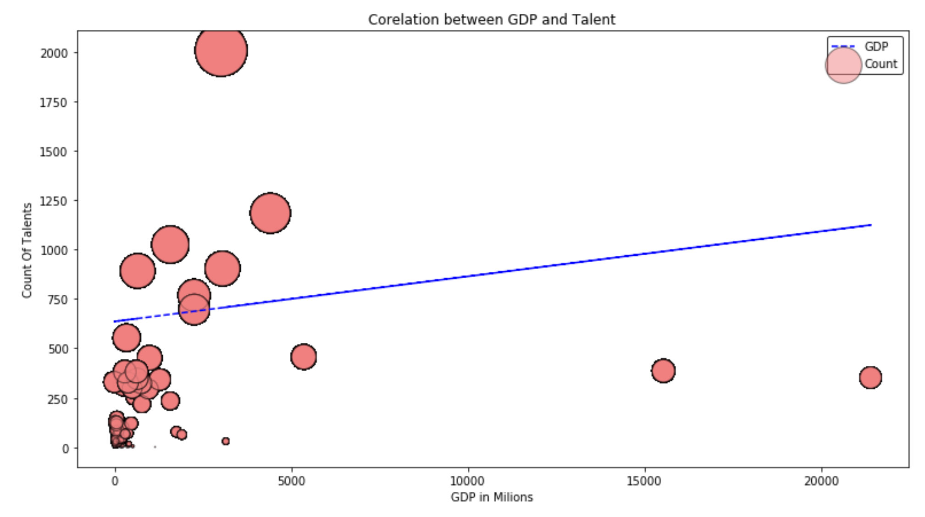














GDP VS Talent
Findings:
Countries produce more talent as the GDP per country increases.
More talent from higher GDP is the contributor to higher overall FIFA wages.
Initial Assumption:
Countries with lower GDP will produce more talent
Null Hypothesis:
Higher GDP promotes higher talent output
*Ensure Jupyter Notebook is available*

Slide 6
Is There a Correlation Between Player Potential and Wage?
Assumption: There is a strong relationship between player potential and player wages.
Null Hypothesis: Players with higher potential will receive higher wages than those identified with lower potential.
Findings: There does not appear to be a strong correlation between Potential and Wages. This could be due to a number of reasons such as injury, age at time of contract, and other reasons.
Stats:
R –squared = 0.195
T = 66.335
*Ensure Jupyter Notebook is available*

Slide 7
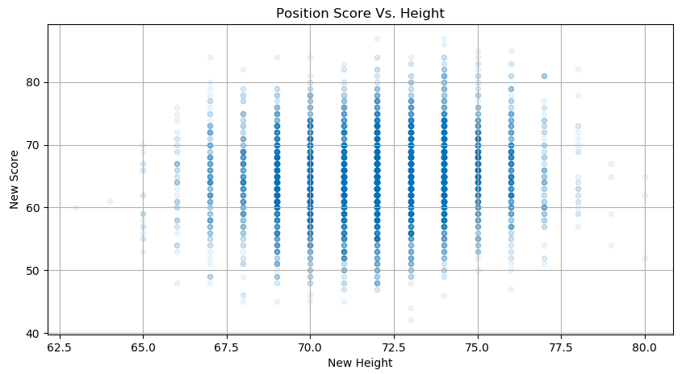
Height vs Score
Assumption:
Defensive players that are taller height would be correlated with a higher player score
Null Hypothesis:
There is no correlation between player height and score
Findings:
Quality Scores >80, the largest grouping exists between 72.5 inches and 75 inches.
Accurate hypothesis – Taller Defensive players have higher player scores.

Slide 8
Conclusion
When comparing a Country’s GDP and talent, we have determined when GDP increases, country produces more talent. This results in FIFA wages to be higher because more talent derives from these countries.
There does not appear to be a strong correlation between Potential and Wages. This could be due to a number of reasons such as injury, age at time of contract, and other reasons.
When reviewing defensive players, it has been determined these players average higher player scores.
*Ensure numerical summary/visuals*

Slide 9
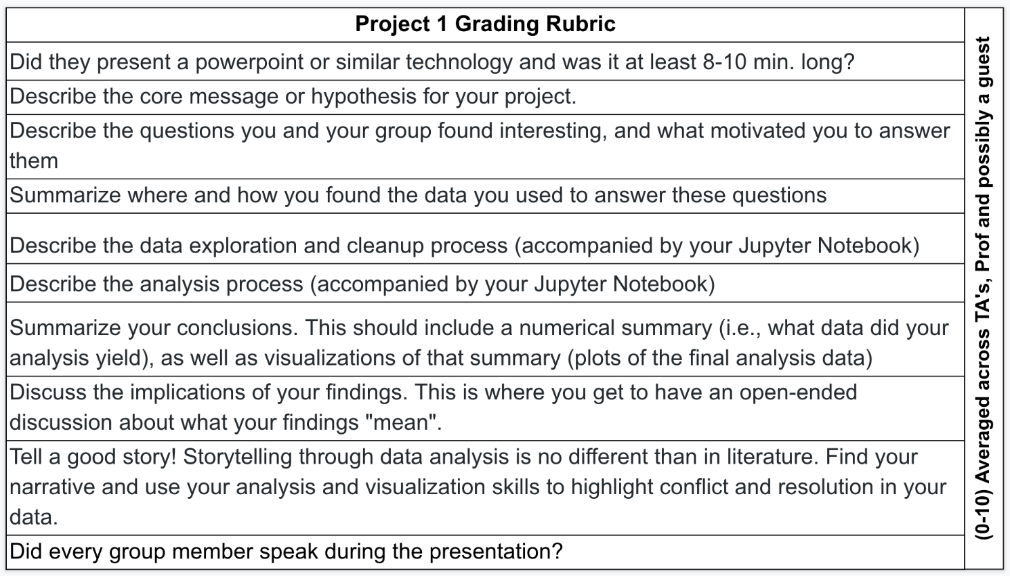
RUBRIC

Slide 10
Presentation Outline
Presentation Time – (8-10 minutes)
Introduction – 2 min
Topic 1 – 2 min
Topic 2 – 1 min
Topic 3 – 1 min
Topic 4 – 1 min
Topic 5 – 1 min
Q/A – 2 min

